Slide 1




Slide 2

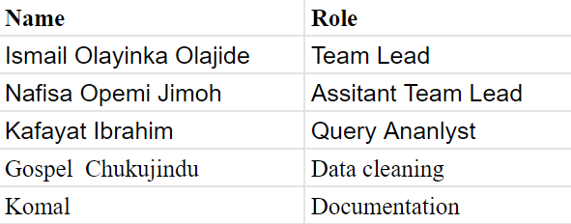

Our Team
Active Members
Ismail Olayinka Olajide
Nafisa Opemi Jimoh
Project Lead
Name: Ismail Olayinka Olajide
Assistant Project Lead
Name: Nafisa Opemi Jimoh
Query Analysts
Name: Kafayat Ibrahim

Slide 3

Problem Statement
To predict the salaries of basketball players for the 2019-20 and 2020-21 seasons
To carry out the above aim, the objectives listed below are duly followed
Data collection and Exploration
Data Normalization and Feature Selection
Training the model
Evaluating the model

Slide 4

Existing Solutions
Existing solutions include :
NBA Salary Predictions from 1995 to 2017
NBA Salary Predictions from 2016 to 2017
NBA Salary Predictions player statistics per game
NBA Salary Predictions using Neural Networks
NBA Salary Predictions using performance of individual players

Slide 5
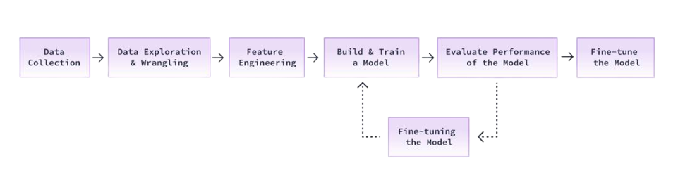

Our Approach
Flow Process
Data Collection
Data Exploration
Data Normalization and Feature Selection
Model Training
Model Evaluation

Slide 6

Dataset Description
The collection of data to train an ML model is a critical step in the machine learning process
The ML system's predictions can only be as good as the data on which they were trained
We used near-perfect data for this problem sourced from Kaggle
The dataset is available here
The cleaned data from the exploratory data analysis (EDA) is used to design the machine learning model

Slide 7
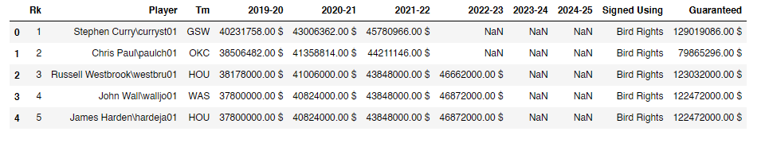
Dataset Description
The dataset comprise of 568 observations and 11 features
No duplicate rows were observed, while 6 columns had missing values

Slide 8

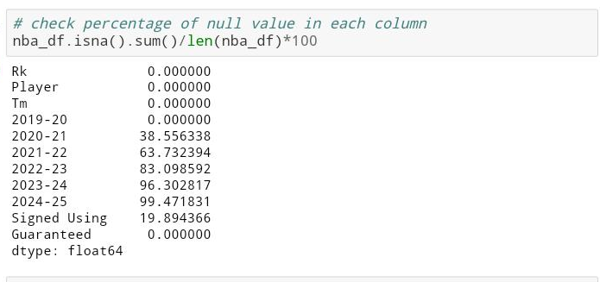
Dataset Description
Missing Value

Slide 9

Data Exploration (EDA)
During the EDA, it was discovered that majorly all numerical columns contains significant numbers except player and rank column which is normally distributed
The 2021-22 salary column happens to have the highest number of outliers, which may be as a result of missing values
This was replaced with the mean of the columns

Slide 10

Data Exploration
The Guaranteed and 2021–22 columns are mostly skewed
At the end of the analysis, it can be seen from the scatter plot that the player ranked as 1 is the highest paid player which also falls as one of the mostly paid player known as Stephen Curry
It is also observed that the maximum salary contract has the least amount of players signed to it, this may be as a result of the team capability to maintain the high price

Slide 11
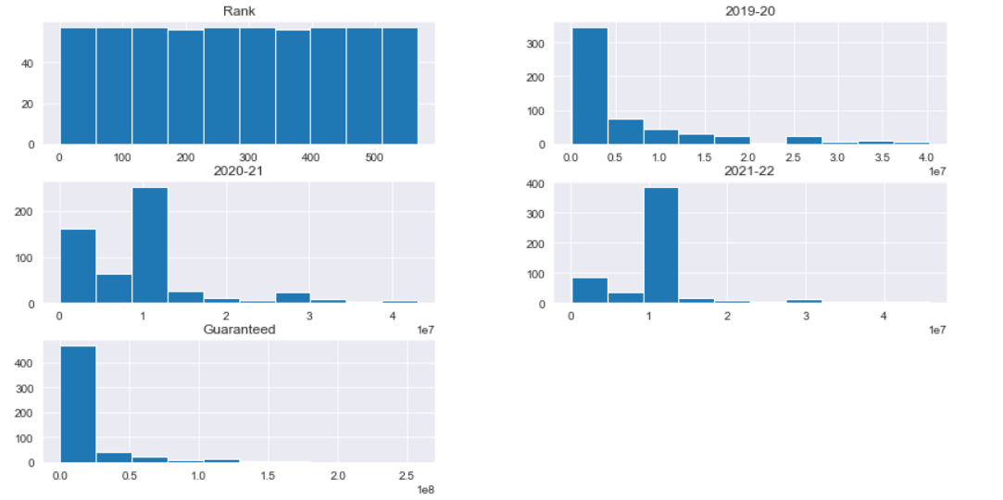
Data Exploration
Histogram of numerical data

Slide 12
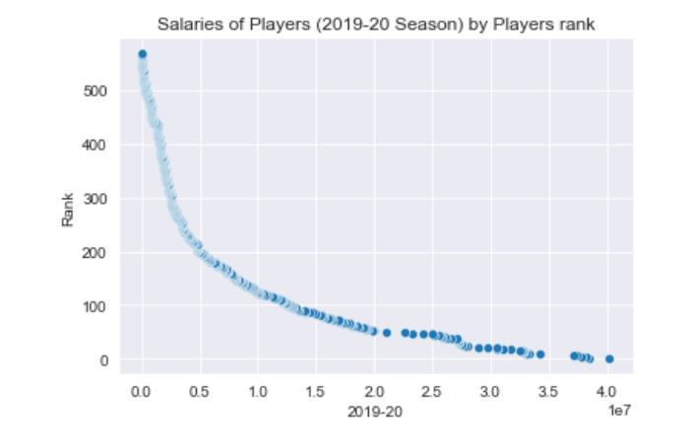
Data Exploration
Relationship between the Rank of the Player and the Salary of the Player
From the plot, it can be deduced that the salaries of players have a negative correlation with the rank of the player
A player ranked as 1 (top player) has the highest salary, while least ranked players have lower salaries

Slide 13
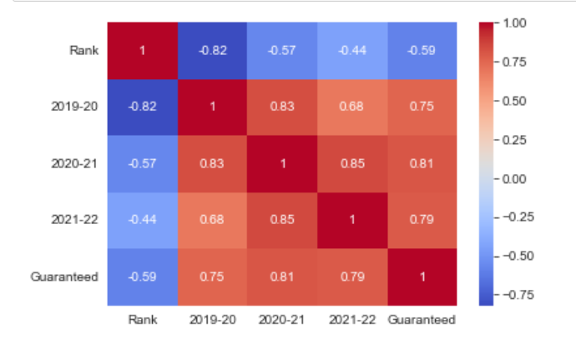
Data Exploration
The correlation between the variables

Slide 14
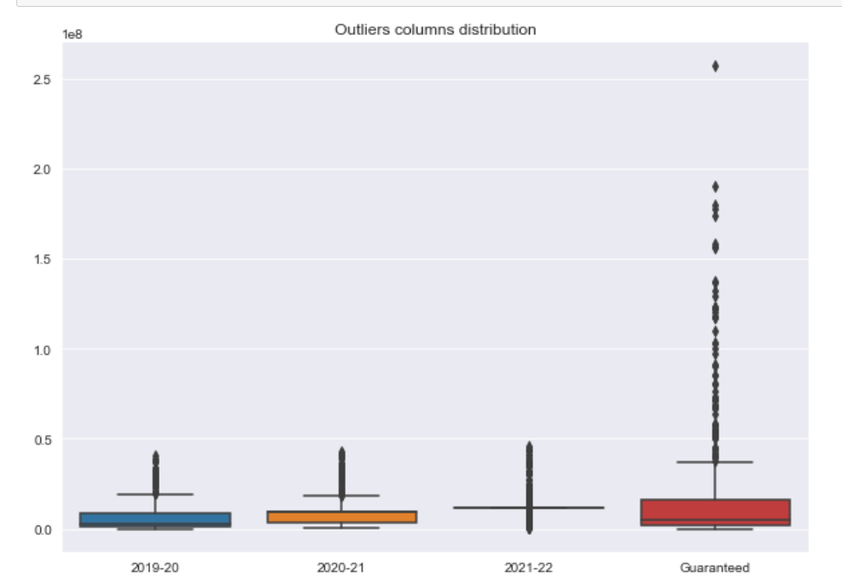
Data Exploration
Outliers in columns

Slide 15
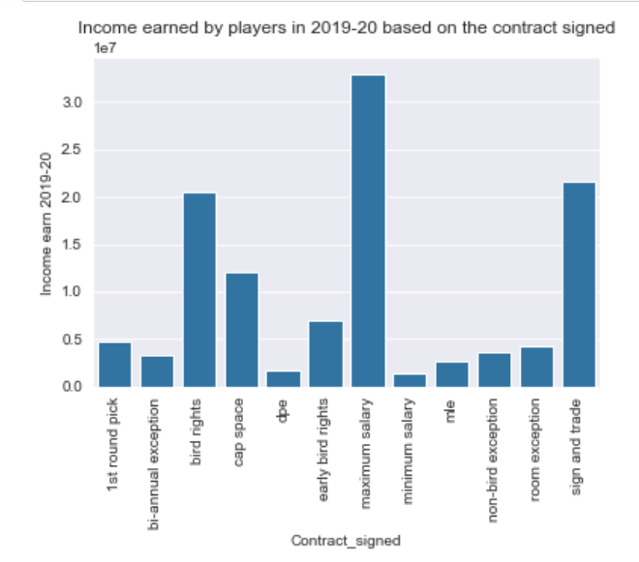
Data Exploration
Average salary paid to the player by the type of contract signed in the year 2019-2020

Slide 16
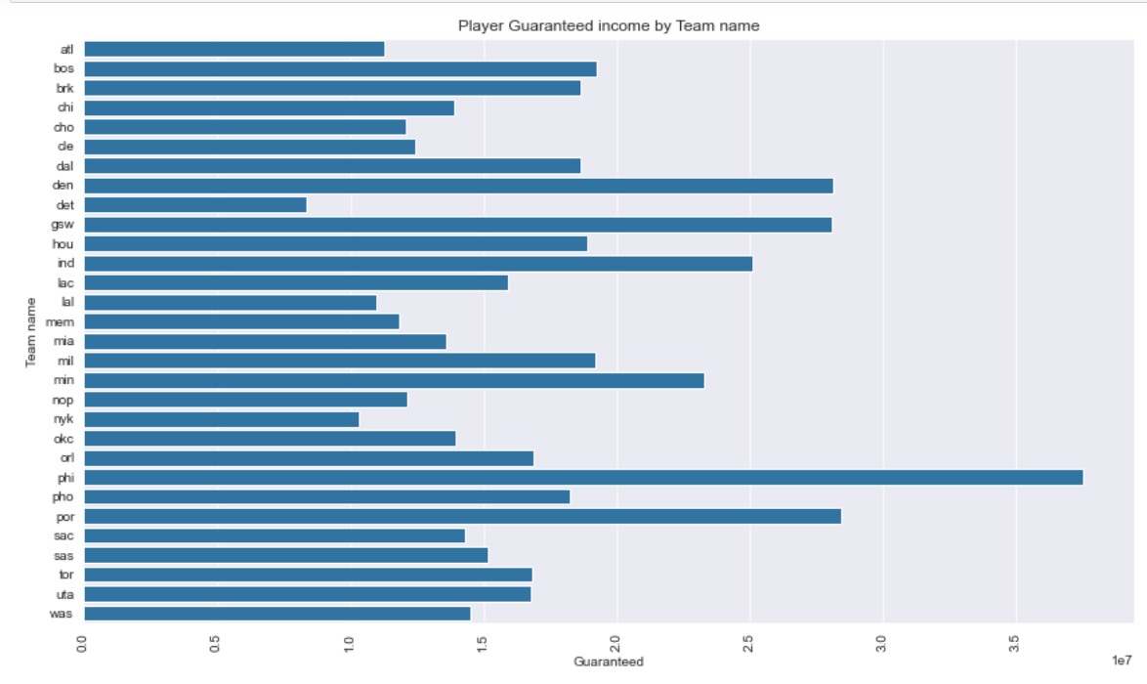
Data Exploration
Team salary by Guaranteed

Slide 17
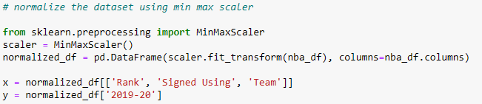
Normalizing the Data and Feature Selection
The values of the features are shifted and scaled to a range of 0 and 1
The independent and dependent variable chosen is shown respectively as x and y in the image

Slide 18
Training the model
The data is split into train and test set with the former taking up 70% of the entire data while the latter uses 30% of the data
Train_test_split from the model_selection class in the sklearn library is a function used to split the data
The entire dataset has 568 samples, 397 are used for training while 171 samples is set aside to be used for testing

Slide 19
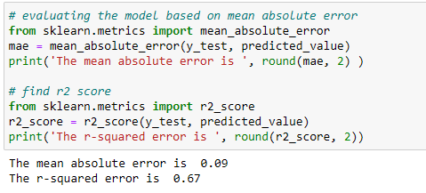
Evaluating the model
The model is evaluated using two metrics: mean absolute error (MAE) and r-squared error
Mean Absolute Error: calculates the sum of the average of the absolute error between the predicted values and the true values
R-squared: used to determine the goodness of fit of the model

Slide 20

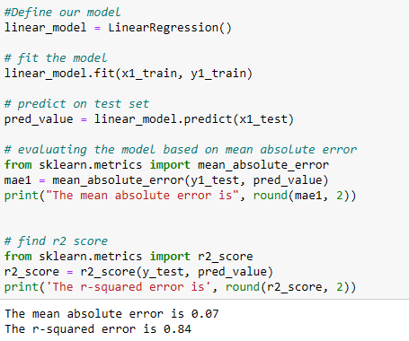
Final Model
Another model that predicts the 2020-21 salaries of the players is developed using linear regression and decision tree algorithm
It follows the same procedure as the steps in the model used above, a linear regression model is used
The mean absolute error after predicting is 0.07 while the coefficient of determination (R2 error) is 0.84
T

Slide 21
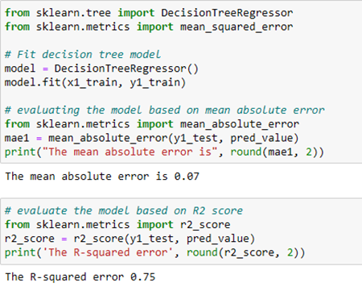
Final Model
When a decision tree algorithm is used. The mean absolute error after predicting is 0.07 while the coefficient of determination (R² error) is 0.75
This shows that the linear regression model had a better R-squared value as compared to the decision tree model

Slide 22

Summary
Two machine learning linear algorithms are used to carry out the prediction - the linear regression and the decision tree algorithm
The first model developed is used to predict the 2019-20 salaries of the players
The second and third model developed is to predict the salaries of the 2020-21 season
The rank and the previous season salary is used as features
The model developed with the linear regression algorithm had a higher coefficient of determination (R2) of 0.84 and a mean absolute error of 0.07
The linear regression performed better than the decision tree algorithm in terms of R2 error
In conclusion, from the predictions made above it can be further deduced that a player's salary will increase as the season increases especially for top players
Due to the limitation of insufficient independent variables and presence of missing data, predictions made are based on salaries of previous year and the rank of the player

Slide 23

Limitations
Enormous null values, limited independent variable.
Limited data
Following feature selection, it was discovered that more than 50% of the features had been eliminated because they included data leaks for the target variable, had low correlation, or were multicollinear.

Slide 24



